Slide 1
The Development and Implementation of Low-Level Control Strategies for a Robust and Effective Low-Cost Rehabilitation Robot for Home Use.
Adam Metcalf
Supervisors: Prof Martin Levesley, Dr Justin Gallagher, Dr Andrew Jackson

Slide 2
Stroke Frequency and Rehabilitation
Stroke likelihood increases with age.
The population of the UK is greying, a trend seen in most of Western Society.
26.5% of the UK population will be aged 65 years or older by 2041 (Office for National Statistics, 2018).
Rehabilitation is more effective when applied intensively and early after Stroke.
Office for National Statistics. 2018. Overview of the UK population: November 2018. [Online].
[Accessed 13 November 2018]. Available from:
https://www.ons.gov.uk/peoplepopulationandcommunity/populationandmigration/populationes
timates/articles/overviewoftheukpopulation/november2018

Slide 3
Stroke effects
Impaired movement control – deficits persist in approximately half of patients 6 months post stroke.
Spasticity – An increase in muscle tone.
Hemiparesis – Weakness of the contralateral limbs.
Abnormal Motor Control – Often exhibits as the loss of ability to simultaneously activate muscles in combination.
Reinkensmeyer, D.J., Dewald, J. and Rymer, W.Z., 1996. Robotic devices for physical rehabilitation of stroke patients: Fundamental requirements, target therapeutic techniques, and preliminary designs. Technology and Disability, 5(2), pp.205-215.
Notes:
Spasticity – The resistance to movement increases with increasing movement amplitude and velocity
Hemiparesis – The limbs are frequently weaker at distal parts, for ie hands and feet.

Slide 4
Rehabilitation Robotics - Overview
Upper Limb and Lower Limb
Exoskeleton and End-effector based
Class 1 and class 2 devices
Notes:
Rehabilitation Robotic devices for Stroke Rehabilitation are classified in a number of ways.
Devices are identified by the targeted areas. Upper limb devices are designed for the rehabilitation of shoulder, elbow, hands, grip etc. Lower Limb devices are designed for gait training, ankle rehabilitation etc.
Devices are exoskeleton, where the limb is supported by a structure which mimics the skeleton, or end effector based, which contact the patient only at the distal part of the limb (the hand in the case of upper limb devices).
Class 1 devices are expensive and are intended for lab or clinic based use. Class 2 devices are less expensive and are designed for unsupervised

Slide 5
Findings of the Literature Review
“need to improve the cost-to-benefit ratio of robot-assisted therapy strategies and their effectiveness for stroke therapy in home environments characterized by the low supervision by clinical experts, low extrinsic motivation as well as low cost requirement” (Johnson et al, 2007).
“rigorous comparison of control algorithms with each other, and with simpler, non-robotic therapy approaches” (Marchal-Crespo and Reinkensmeyer, 2009).
Reinkensmeyer, D.J., Takahashi, C.D., Timoszyk, W.K., Reinkensmeyer, A.N. and Kahn, L.E., 2001. Design of robot assistance for arm movement therapy following stroke. Advanced robotics, 14(7), pp.625-637.
Marchal-Crespo, L. and Reinkensmeyer, D.J., 2009. Review of control strategies for robotic movement training after neurologic injury. Journal of NeuroEngineering and rehabilitation, 6(1), p.20.
Notes:
Findings from the literature review justify the aims of MyPAM:
Improve the cost-to-benefit ratio, specifically mentioning the requirement for lost cost solutions to enhance patient accessibility to rehabilitation robotics.
A comparison of low-level control algorithms

Slide 6
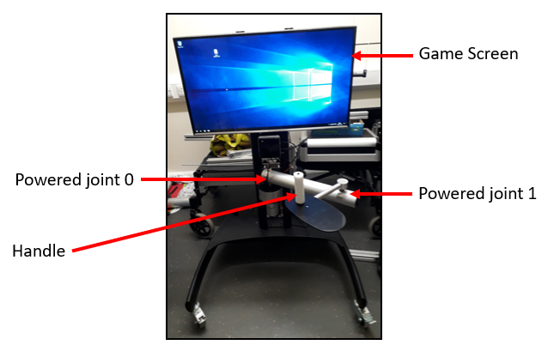
MyPAM – Overview
2 DoF powered joystick. Class 2, end effector based robot for upper limb rehabilitation.
Currently only uses position PID control for the low-level control strategy.

Slide 7
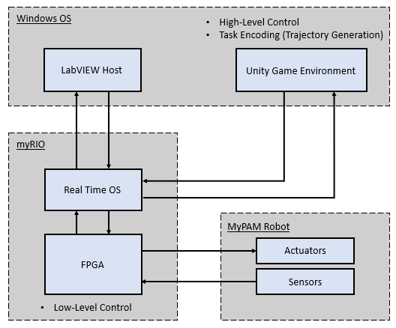
MyPAM – Current Architecture
Notes:
RealTime OS on myRIO communicates with Unity via TCP

Slide 8
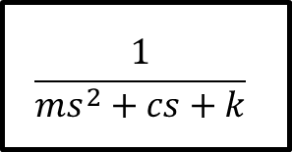
Admittance Control
Admittance filter
$$\frac{1}{{ms}^{2}+cs+k}$$
F_{ext}
Position
Demand
(P_{D})
Desired
Position
(P_{T})
+
Position
Controller
Plant
+
-
Actual position (P_{A})

Slide 9
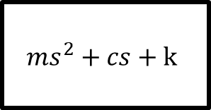
Impedance Control
Impedance filter
$${ms}^{2}+cs+k$$
P_{ext}
Force
Demand
(F_{D})
Desired
Force
(F_{T})
+
Force
Controller
Plant
+
-
Actual Force (F_{A})

Slide 10

Current work
Trajectory generation and integration
End effector force sensor
Admittance control

Slide 11


Trajectory Generation and Integration
$$x\left(t\right)= x_{i}+\left(x_{f}−x_{i}\right)\left(6{\left(\frac{t}{t_{f}}\right)}^{5}−15{\left(\frac{t}{t_{f}}\right)}^{4}+10{\left(\frac{t}{t_{f}}\right)}^{3}\right)$$
$$y\left(t\right)= y_{i}+\left(y_{f}−y_{i}\right)\left(6{\left(\frac{t}{t_{f}}\right)}^{5}−15{\left(\frac{t}{t_{f}}\right)}^{4}+10{\left(\frac{t}{t_{f}}\right)}^{3}\right)$$

Slide 12
End Effector Force Sensor – Design
A necessary component for the advanced low-level control schemes is the ability to measure the interaction force at the end-effector.
Industrial force sensors are costly – does not meet the specifications of a low-cost device.
Bespoke solutions have other disadvantages – finding the balance between the disadvantages and utility.

Slide 13
End Effector Force Sensor – Neural Network

Slide 14
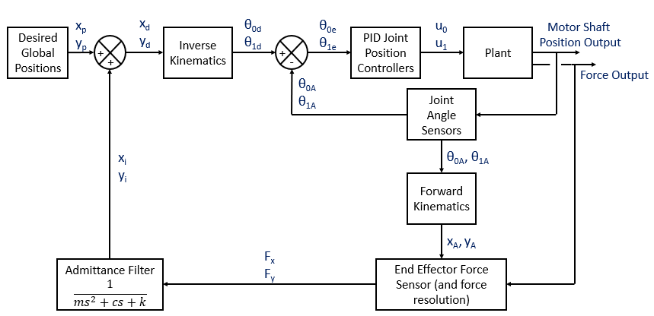
Admittance Control - Design

Slide 15
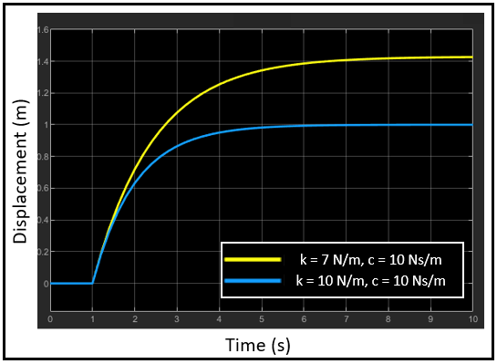
Admittance Control - Implementation
What gains to use for k, c and m? To be determined heuristically when testing.
Timing issue – instantaneous data means that there is no change in time t

Slide 16
Future work
Systems Rearchitecture
Force Sensor
Testing Admittance Control
Impedance Control
Human Based Testing

